Slide 1

Chapter 5::
Target Machine Architecture
Programming Language Pragmatics
Michael L. Scott
Copyright © 2009 Elsevier

Slide 2
Assembly-Level View
As mentioned early in this course, a compiler is simply a translator
  It translates programs written in one language into programs written in
  another language
    This other language can be almost anything
    Most of the time, however, it's the machine language for some available computer
Copyright © 2009 Elsevier

Slide 3
Assembly-Level View
As a review, we will go over some of the material most relevant to language implementation, so that we can better understand
  what the compiler has to do to your program
  why certain things are fast and others slow
  why certain things are easy to compile and others aren't
Copyright © 2009 Elsevier

Slide 4
Assembly-Level View
There are many different programming languages and there are many different machine languages
  Machine languages show considerably less diversity than programming languages
  Traditionally, each machine language corresponds to a different computer ARCHITECTURE
  The IMPLEMENTATION is how the architecture is realized in hardware
Copyright © 2009 Elsevier

Slide 5
Assembly-Level View
Formally, an architecture is the interface to the hardware
  what it looks like to a user writing programs on the bare machine.
In the last 20 years, the line between these has blurred to the point of disappearing
  compilers have to know a LOT about the implementation to do a decent job
Copyright © 2009 Elsevier

Slide 6
Assembly-Level View
Changes in hardware technology (e.g., how many transistors can you fit on one chip?) have made new implementation techniques possible
  the architecture was also modified
  Example: RISC (reduced instruction set computer) revolution ~20 years ago
In the discussion below, we will focus on modern RISC architectures, with a limited amount of coverage of their predecessors, the CISC architectures
Copyright © 2009 Elsevier

Slide 7
Workstation Macro-Architecture
Most modern computers consist of a collection of DEVICES that talk to each other over a BUS
From the point of view of language implementation:
  the most important device is the PROCESSOR(S)
  the second most important is main memory
  other devices include: disks, keyboards, screens, networks, general-purpose serial/parallel ports, etc.
Copyright © 2009 Elsevier

Slide 8
Workstation Macro-Architecture
Almost all modern computers use the (von Neumann) stored program concept:
  a program is simply a collection of bits in memory that the computer interprets as instructions, rather than as integers, floating point numbers, or some other sort of data
What a processor does is repeatedly
  fetch an instruction from memory
  decode it - figure out what it says to do
  fetch any needed operands from registers or memory
  execute the operation, and
  store any result(s) back into registers or memory
Copyright © 2009 Elsevier

Slide 9
Workstation Macro-Architecture
This set of operations is referred to as the fetch-execute cycle
  The computer runs this cycle at a furious pace, never stopping, regardless of the meaning of the instructions
    You can point a processor's instruction fetch logic at a long string of floating point numbers and it will blithely begin to execute them; it will do something, though that something probably won't make much sense
    Operating systems are designed so that when the computer has nothing useful to do it is pointed at an infinite loop that it can execute furiously, but harmlessly
Copyright © 2009 Elsevier

Slide 10
Workstation Macro-Architecture
The crucial components of a typical processor include a collection of FUNCTIONAL UNITS:
  hardware to decode instructions and drive the other functional units
  hardware to fetch instructions and data from memory and to store them back again if they are modified
  one or more arithmetic/logic units (ALUs) to do actual computations
  registers to hold the most heavily-used parts of the state of the computation
  hardware to move data among the various functional units and registers
Copyright © 2009 Elsevier

Slide 11
Memory Hierarchy
Memory is too big to fit on one chip with a processor
  Because memory is off-chip (in fact, on the other side of the bus), getting at it is much slower than getting at things on-chip
  Most computers therefore employ a MEMORY HIERARCHY, in which things that are used more often are kept close at hand
Copyright © 2009 Elsevier

Slide 12
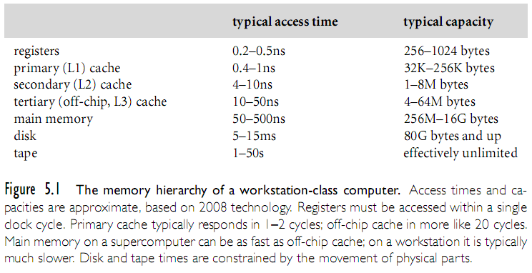
Memory Hierarchy
Copyright © 2009 Elsevier

Slide 13
Memory Hierarchy
Some of these levels are visible to the programmer; others are not
For our purposes here, the levels that matter are registers and main memory
Registers are special locations that can hold (a very small amount of) data that can be accessed very quickly
  A typical RISC machine has a few (often two) sets of registers that are used to hold integer and floating point operands
Copyright © 2009 Elsevier

Slide 14
Memory Hierarchy
It also has several special-purpose registers, including the
  program counter (PC)
    holds the address of the next instruction to be executed
    usually incremented during fetch-execute cycle
  processor status register
    holds a variety of bits of little interest in this course (privilege level, interrupt priority level, trap enable bits)
Copyright © 2009 Elsevier

Slide 15
Data Representation
Memory is usually (but not always) byte-addressable, meaning that each 8-bit piece has a unique address
  Data longer than 8 bits occupy multiple bytes
  Typically
    an integer occupies 16, 32, or (recently) 64 bits
    a floating point number occupies 32, 64, or (recently) 128 bits
Copyright © 2009 Elsevier

Slide 16
Data Representation
It is important to note that, unlike data in high-level programming languages, memory is untyped (bits are just bits)
Operations are typed, in the sense that different operations interpret the bits in memory in different ways
Typical DATA FORMATS include
  instruction
  integer (various lengths)
  floating point (various lengths)
Copyright © 2009 Elsevier

Slide 17
Data Representation
Other concepts we will not detail but covered in other courses
  Big-endian vs. little-endian (for details see Figure 5.2)
  Integer arithmetic
    2's complement arithmetic
  Floating-point arithmetic
    IEEE standard, 1985
Copyright © 2009 Elsevier

Slide 18
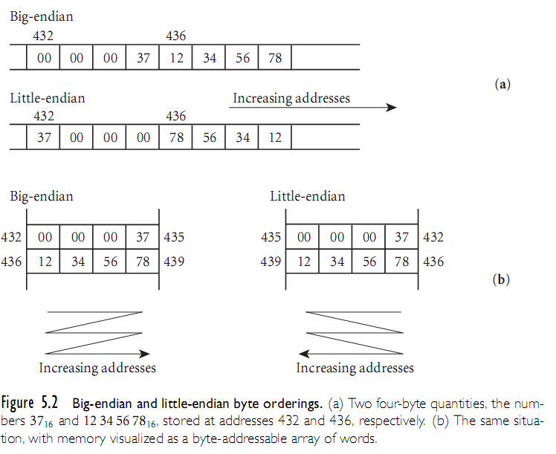
Data Representation
Copyright © 2009 Elsevier

Slide 19
Instruction-Set Architecture
The set of instructions executed by a modern processor may include:
  data movement (load, store, push, pop, movem, swap - registers)
  arithmetic and logical (negate, extend, add, subtract, multiply, divide, and, or, shift)
  control transfer (jump, call, trap - jump into the operating system, return - from call or trap, conditional branch)
Copyright © 2009 Elsevier

Slide 20
Instruction-Set Architecture
Addressing Modes
Instructions can specify many different ways to obtain their data (Addressing Modes)
  data in instruction
  data in register
  address of data in instruction
  address of data in register
  address of data computed from two or more values contained in the instruction and/or registers
Copyright © 2009 Elsevier

Slide 21
Instruction-Set Architecture
Addressing Modes
On a RISC machine, arithmetic/logic instructions use only the first two of these ADDRESSING MODES
  load and store instructions use the others
On a CISC machine, all addressing modes are generally available to all instructions
  CISC machines typically have a richer set of addressing modes, including some that perform
    multiple indirections, and/or
    arithmetic computations on values in memory in order to calculate an effective address
Copyright © 2009 Elsevier

Slide 22
Architecture Implementation
As technology advances, there are occasionally times when some threshold is crossed that suddenly makes it possible to design machines in a very different way
  One example of such a paradigm shift occurred in the mid 1980s with the development of RISC (reduced instruction set computer) architectures
Copyright © 2009 Elsevier

Slide 23
Architecture Implementation
During the 1950s and the early 1960s, the instruction set of a typical computer was implemented by soldering together large numbers of discrete components that performed the required operations
    To build a faster computer, one generally designed extra, more powerful instructions, which required extra hardware
    This has the unfortunate effect of requiring assembly language programmers to learn a new language
Copyright © 2009 Elsevier

Slide 24
Architecture Implementation
IBM hit upon an implementation technique called MICROPROGRAMMING:
  same instruction set across a whole line of computers, from cheap to fast machines
  basic idea of microprogramming
    build a microengine in hardware that executed a interpreter program in firmware
      interpreter implemented IBM 360 instruction set
    more expensive machines had fancier microengines
      more of the 360 functionality in hardware
      top-of-the-line machines had everything in hardware
Copyright © 2009 Elsevier

Slide 25
Architecture Implementation
Microprogramming makes it easy to extend the instruction set
    people ran studies to identify instructions that often occurred in sequence (e.g., the sequence that jumps to a subroutine and updates bookkeeping information in the stack)
    then provided new instructions that performed the function of the sequence
    By clever programming in the firmware, it was generally possible to make the new instruction faster than the old sequence, and programs got faster.
Copyright © 2009 Elsevier

Slide 26
Architecture Implementation
The microcomputer revolution of the late 1970s (another paradigm shift) occurred when it became possible to fit a microengine onto a single chip (microprocessor):
  personal computers were born
  by the mid 1980s, VLSI technology reached the point where it was possible to eliminate the microengine and still implement a processor on a single chip
Copyright © 2009 Elsevier

Slide 27
Architecture Implementation
With a hardware-only processor on one chip, it then became possible to apply certain performance-enhancing tricks to the implementation, but only if the instruction set was very simple and predictable
  This was the RISC revolution
  Its philosophy was to give up "nice", fancy features in order to make common operations fast
Copyright © 2009 Elsevier

Slide 28
Architecture Implementation
RISC machines:
  a common misconception is that small instruction sets are the distinguishing characteristic of a RISC machine
  better characterization: RISC machines are machines in which at least one new instruction can (in the absence of conflicts) be started every cycle (hardware clock tick)
    all possible mechanisms have been exploited to minimize the duration of a cycle, and to maximize the number of functional units that operate in parallel during a given cycle
Copyright © 2009 Elsevier

Slide 29
Architecture Implementation
Reduced cycle time comes from making all instructions simple and regular
  Simple instructions never have to run slowly because of extra logic necessary to implement the complicated instructions
  Maximal parallelism comes from giving the instructions a very regular, predictable format
    the interactions between instructions are clear and the processor can begin working on the next instruction before the previous one has finished
Copyright © 2009 Elsevier

Slide 30
Compiling for Modern Processors
PIPELINING is probably the most important performance enhancing trick
  It works kind of like this:
TIME →
fetch decode fetch execute store
instr instr data data
fetch decode fetch execute store
instr instr data data
fetch decode fetch execute store
instr instr data data
Copyright © 2009 Elsevier

Slide 31
Compiling for Modern Processors
The processor has to be careful not to execute an instruction that depends on a previous instruction that hasn't finished yet
  The compiler can improve the performance of the processor by generating code in which the number of dependencies that would stall the pipeline is minimized
  This is called INSTRUCTION SCHEDULING; it's one of the most important machine-specific optimizations for modern compilers
Copyright © 2009 Elsevier

Slide 32
Compiling for Modern Processors
Loads and load delays are influenced by
  Dependences
    Flow dependence
    Anti-dependence
    Output dependence
Branches
  since control can go both ways, branches create delays
Copyright © 2009 Elsevier

Slide 33
Compiling for Modern Processors
Usual goal: minimize pipeline stalls
Delay slots
  loads and branches take longer than ordinary instructions
  loads have to go to memory, which is slow
  branches disrupt the pipeline
  processor have interlock hardware
  early RISC machines often provided delay slots for the second (maybe third) cycle of a load or store instruction, during which something else can occur
  the instruction in a branch delay slot gets executed whether the branch occurs or not
Copyright © 2009 Elsevier

Slide 34
Compiling for Modern Processors
Delay slots (continued)
  the instruction in a load delay slot can't use the loaded value
  as pipelines have grown deeper, people have generally realized that delay slots are more trouble than they're worth
  most current processor implementations interlock all loads, so you don't have to worry about the correctness issues of load delay
  some machines still have branch delay slots (so they can run code written in the late '80s)
    later implementations usually provide a nullifying alternative that skips the instruction in the slot if static branch prediction is wrong
Copyright © 2009 Elsevier

Slide 35
Compiling for Modern Processors
Unfortunately, even this start a new instruction every cycle characterization of RISC machines is inadequate
  In all honesty, there is no good clear definition of what RISC means
Most recent RISC machines (and also the most recent x86 machines) are so-called SUPERSCALAR implementations that can start more than one instruction each cycle
Copyright © 2009 Elsevier

Slide 36
Compiling for Modern Processors
If it's a CISC machine, the number of instructions per second depends crucially on the mix of instructions produced by the compiler
  the MHz number gives an upper bound (again assuming a single set of functional units)
  if it's a "multi-issue“ (superscalar) processor like the PowerPC G3 or Intel machines since the Pentium Pro, the upper bound is higher than the MHz number
Copyright © 2009 Elsevier

Slide 37
Compiling for Modern Processors
As technology improves, complexity is beginning to creep back into RISC designs
Right now we see "RISC" machines with on-chip
  vector units
  memory management units
  large caches
Copyright © 2009 Elsevier

Slide 38
Compiling for Modern Processors
We also see "CISC" machines (the Pentium family) with RISC-like subsets (single-cycle hard-coded instructions)
In the future, we might see
  large amounts of main memory
  multiple processors
  network interfaces (now in prototypes)
  additional functions
    digital signal processing
Copyright © 2009 Elsevier

Slide 39
Compiling for Modern Processors
In addition, the 80x86 instruction set will be with us for a long time, due to the huge installed base of IBM-compatible PCs
  After a failed attempt to introduce its own RISC architecture (the i860), Intel has for the last three years been working with HP on the RISC-like Merced, or IA64, architecture, which will remain provide a compatibility mode for older x86 programs
Copyright © 2009 Elsevier

Slide 40
Compiling for Modern Processors
In a sense, code for RISC machines resembles microcode
  Complexity that used to be hidden in firmware must now be embedded in the compiler
  Some of the worst of the complexity (e.g. branch delay slots) can be hidden by the assembler (as it is on MIPS machines)
    it is definitely true that it is harder to produce good (fast) code for RISC machines than it is for CISC machines
Copyright © 2009 Elsevier

Slide 41
Compiling for Modern Processors
Example: the Pentium chip runs a little bit faster than a 486 if you use the same old binaries
  If you recompile with a compiler that knows to use a RISC-like subset of the instruction set, with appropriate instruction scheduling, the Pentium can run much faster than a 486
Copyright © 2009 Elsevier

Slide 42
Compiling for Modern Processors
Multiple functional units
  superscalar machines can issue (start) more than one instruction per cycle, if those instructions don't need the same functional units
  for example, there might be two instruction fetch units, two instruction decode units, an integer unit, a floating point adder, and a floating point multiplier
Copyright © 2009 Elsevier

Slide 43
Compiling for Modern Processors
Because memory is so much slower than registers, (several hundred times slower at present) keeping the right things in registers is extremely important
  RISC machines often have at least two different classes of registers (so they don't have to support all operations on all registers) which the compiler has to keep track of
Copyright © 2009 Elsevier

Slide 44
Compiling for Modern Processors
Some (SPARC) have a complicated collection of overlapping REGISTER WINDOWS
Finally, good register allocation sometimes conflicts with good instruction scheduling
  code that makes ideal use of functional units may require more registers than code that makes poorer use of functional units
  good compilers spend a *great* deal of effort
    make sure that the data they need most is in register
Copyright © 2009 Elsevier

Slide 45
Compiling for Modern Processors
Note that instruction scheduling and register allocation often conflict
Limited instruction formats/more primitive instructions
  Many operations that are provided by a single instruction on a CISC machine take multiple instructions on a RISC machine
  For example, some RISC machines don't provide a 32-bit multiply; you have to build it out of 4-bit (or whatever) multiplies
Copyright © 2009 Elsevier

Slide 46
Compiling For Modern Machines
To make all instructions the same length
  data values and parts of addresses are often scaled and packed into odd pieces of the instruction
  loading from a 32-bit address contained in the instruction stream takes two instructions, because one instruction isn't big enough to hold the whole address and the code for load
    first instruction loads part of the address into a register
    second instruction adds the rest of the address into the register and performs the load
Copyright © 2009 Elsevier

Slide 47
Summary
There are currently four (4) major RISC architectures:
  ARM (Intel, Motorola, TI, etc)
  SPARC (Sun, TI, Fujitsu)
  Power/Power PC (IBM, Motorola. Apple)
  MIPS (SGI, NEC)
Currently there is growing demand for 64-bit addressing (Intel, AMD)
Copyright © 2009 Elsevier

